Slide 1
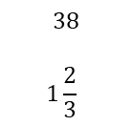
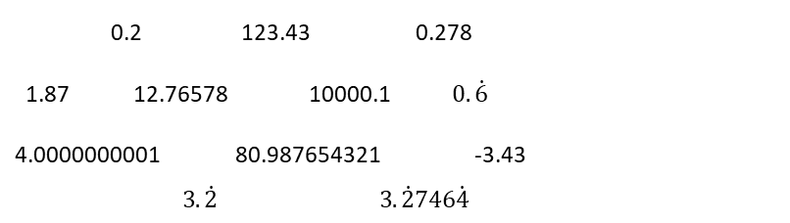
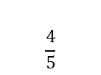
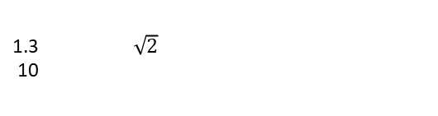
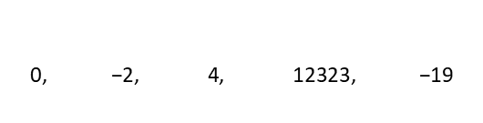
Subtopic N1.6 – Decimal place value
LEARNING OUTCOME: To understand place value for decimal numbers
Objectives:
Keywords:
Decimal
Tenth
Hundredth
Thousandth
To understand representations of tenths hundredths and thousandths.
To compose and decompose decimal values into their place values.
Introduction – Read and annotate:
Decimal place value extends our number system by introducing new columns to the right of the
decimal point, such as tenths, hundredths, and thousandths. Each new place is one-tenth the value
of the place to its left, just like how tens and hundreds work on the left side of the decimal. This
“thousandths” aspect of the terminology helps us read, write, and compare numbers that are smaller
than one, making it easier to work with precise measurements, money, and real-world data.
Definition
Characteristics
A decimal is a number that is not whole, as it lies between whole numbers.
Consists of a whole and a fraction part.
The fractional part is written as digits after a point rather than a fraction.
The whole and fraction parts are separated by a point called the decimal point.
Can be terminating or recurring.
Examples
Decimal
Non - Examples
240
Identifying place value in decimals
Example 1 - I do…
Example 2 – We do…
Example 3 – You do…
Steps | Write down the value of the underlined digit | Write down the value of the underlined digit | Write down the value of the underlined digit
1) Identify the underlined digit. | 3.478 4 tenths or 0.4 | 23.358 5 hundredths or 0.05 | 14.369 9 thousandths or 0.009
2) Identify the place value of the underlined digit.

Slide 2
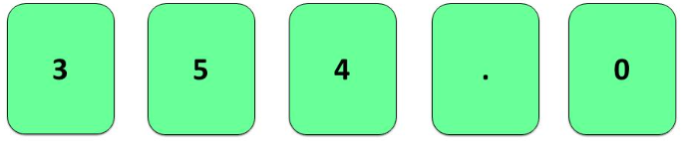
Independent Practice
Question 1. Write down the value of the underlined digit:
a) 2.401 | b) 2.421 | c) 0.3281 | d) 0.3281 | e) 1.002
f) 1.928 | g) 19.27 | h) 0.129 | i) 1.92 | j) 0.879
8 thousandths
0.008
2 hundredths
0.02
3 tenths
0.3
4 tenths
0.4
1
9 thousandths
0.009
7 hundredths
0.07
2 hundredths
0.02
9 tenths
0.9
9 tenths
0.9
Question 2. Write down the value of the 3 in each of the following numbers:
a) 123.456 | b) 321.456 | c) 4321.456 | d) 4321.4567
e) 4231.4567 | f) 3241.4567 | g) 30241.4567 | h) 3024.14567
i) 3.02414567 | j) 456.123 | k) 456.321 | l) 456.4321
3 hundreds
300
3 hundreds
300
3 ones
3
3 hundreds
300
3 thousands
3000
3 thousand
3000
3 tens
30
Thirty thousand
30000
3 thousandths
0.003
3 tenths
0.3
3 ones
3
3 hundredths
0.03
Question 3. What is the smallest number that can be made using all of the cards?
0.345

Slide 3
Decimals as sums of fractions
Example 4 - I do…
Example 5 – We do…
Example 6 – You do…
Steps | Write the decimal as a sum of fractions | Write the decimal as a sum of fractions | Write the decimal as a sum of fractions
1) Identify the place value of each digit. 2) Re-write the value as a sum of each of its digits place value
Independent Practice
Question 3. Write the following decimals as a sum of fractions
a) 0.1 | b) 0.01 | c) 0.6 | d) 0.07
e) 0.12 | f) 0.31 | g) 0.60 | h) 0.001
i) 0.143 | j) 0.301 | k) 1.437 | l) 7.057
Example 7 - I do…
Example 8 – We do…
Example 9 – You do…
Steps | Write the sum of fractions in decimal form | Write the sum of fractions in decimal form | Write the sum of fractions in decimal form
Re-write the value as a sum of each of its digits place value

Slide 4
Independent Practice
Question 4. Write the following as decimals.
0.7
0.003
0.3
0.09
0.79
1.7
0.793
0.703
13.17
1.007
2.508
3.142
Skills Check
What is the value of the underlined digit in this number? 31.405 4 B. 0.4 0.04 D. 0.004
Write the number nine hundredths in figures 0.09 B. 0.9 0.009 D. 900

